Slide 1


CovidPileup – A Pipeline for COVID-19 Variation Analysis from Whole Genome Sequences
https://github.com/wtsi-hpag/covidPileup
Zemin Ning
The Wellcome Sanger Institute
UK

Slide 2
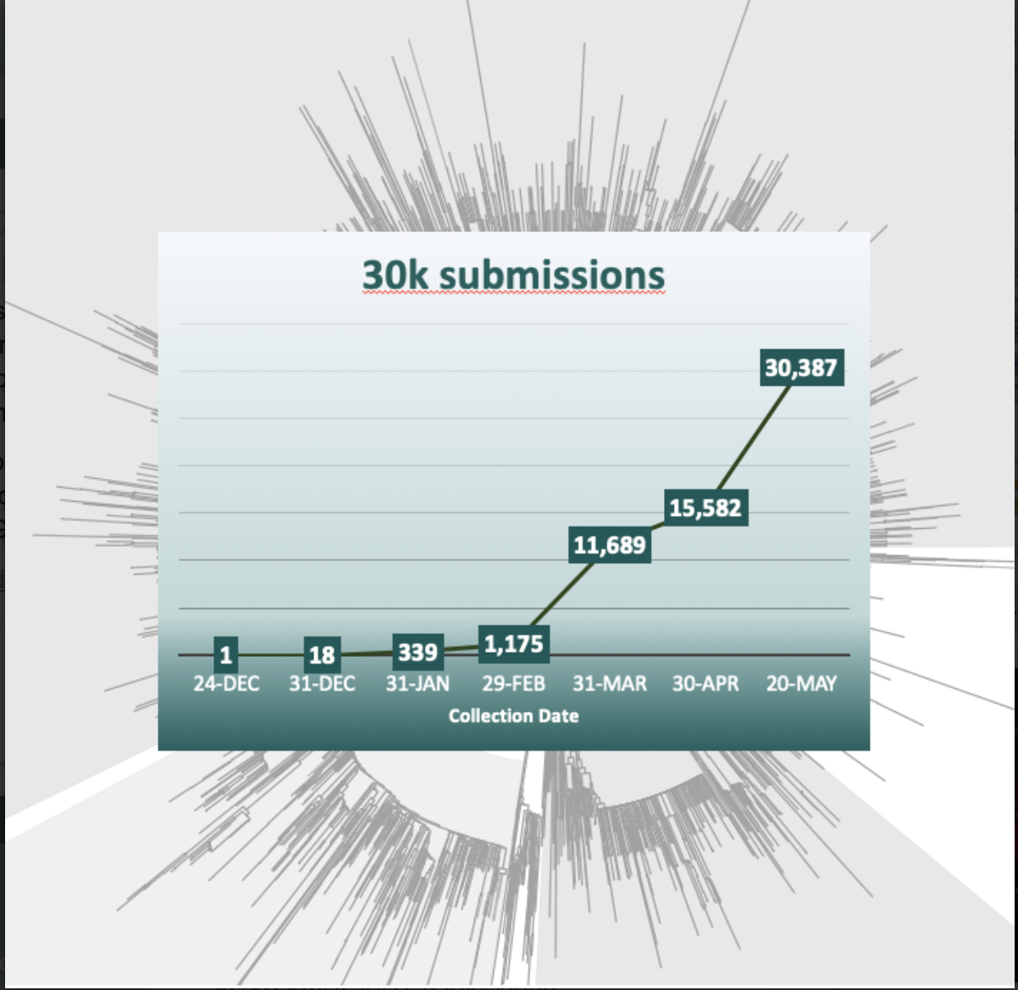

Slide 4
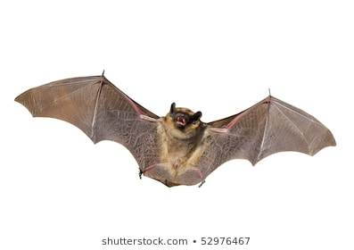
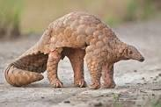


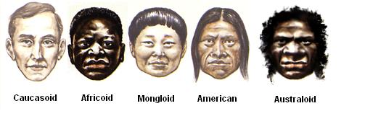
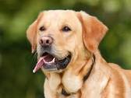

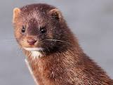
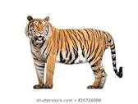
Viral Genomes and SNPs
Species | #Samples | Average_SNPs
Bat | 3 | 2424
Pangolin | 9 | 3466
Human | 30387 | 7
Dog | 2 | 8
Cat | 1 | 8
Mink | 13 | 10
Tiger | 1 | 6
Environment* | 12 | 7
*Likely DNA was extracted from air

Slide 5
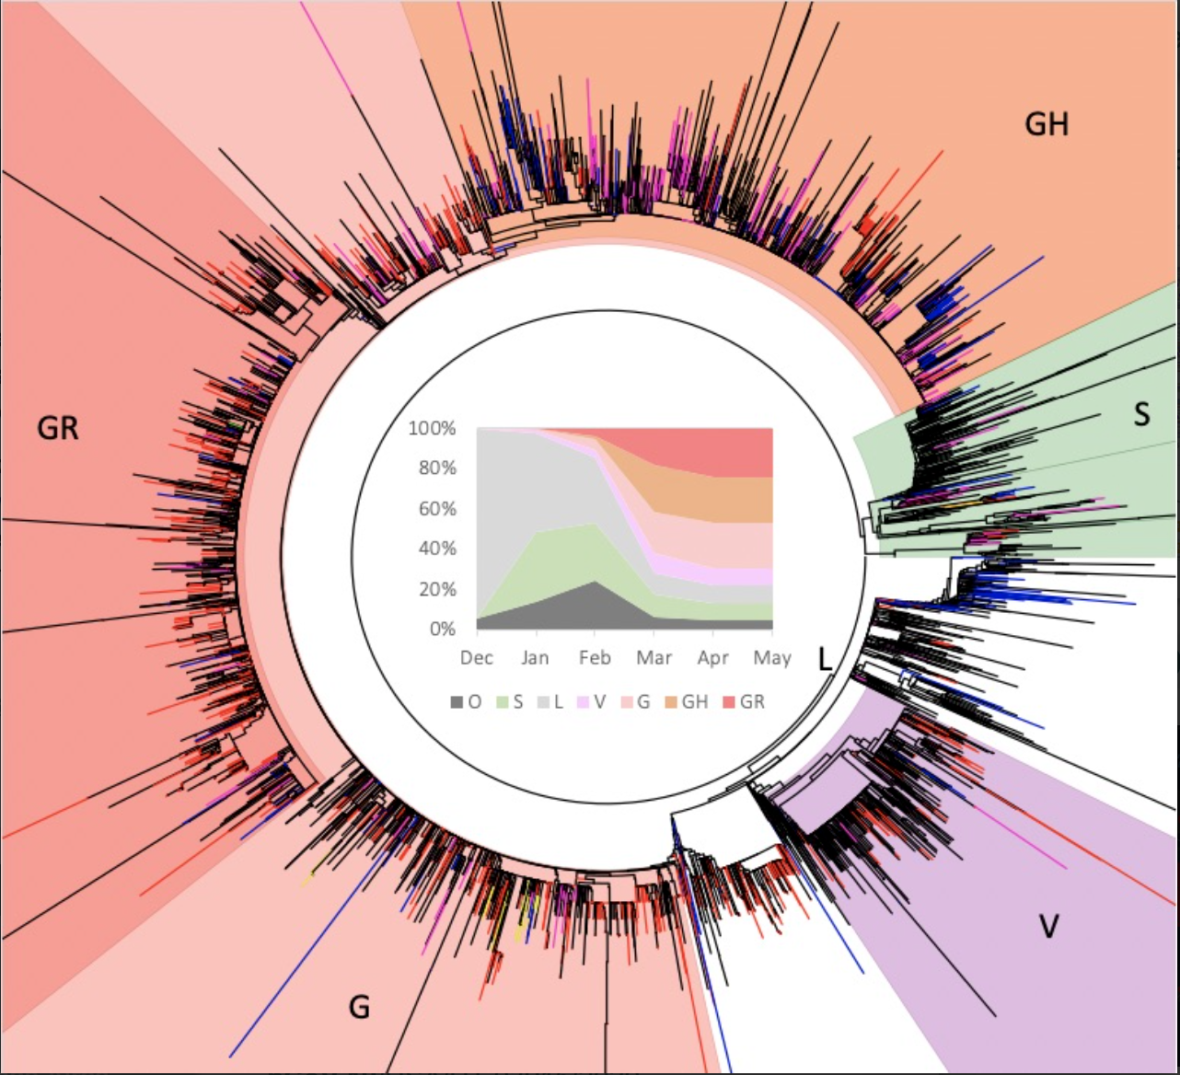

Slide 6
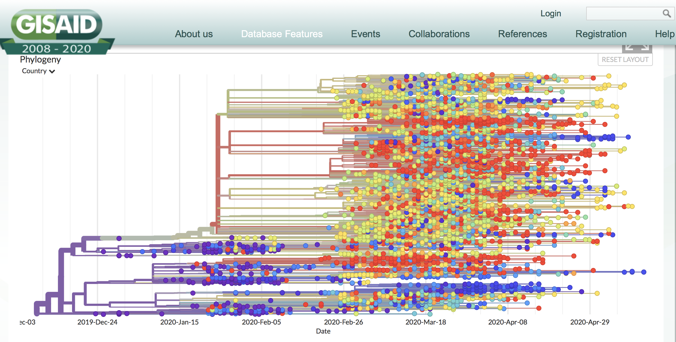

Slide 7
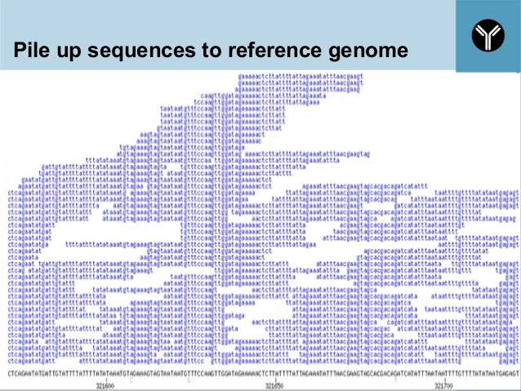

Slide 8









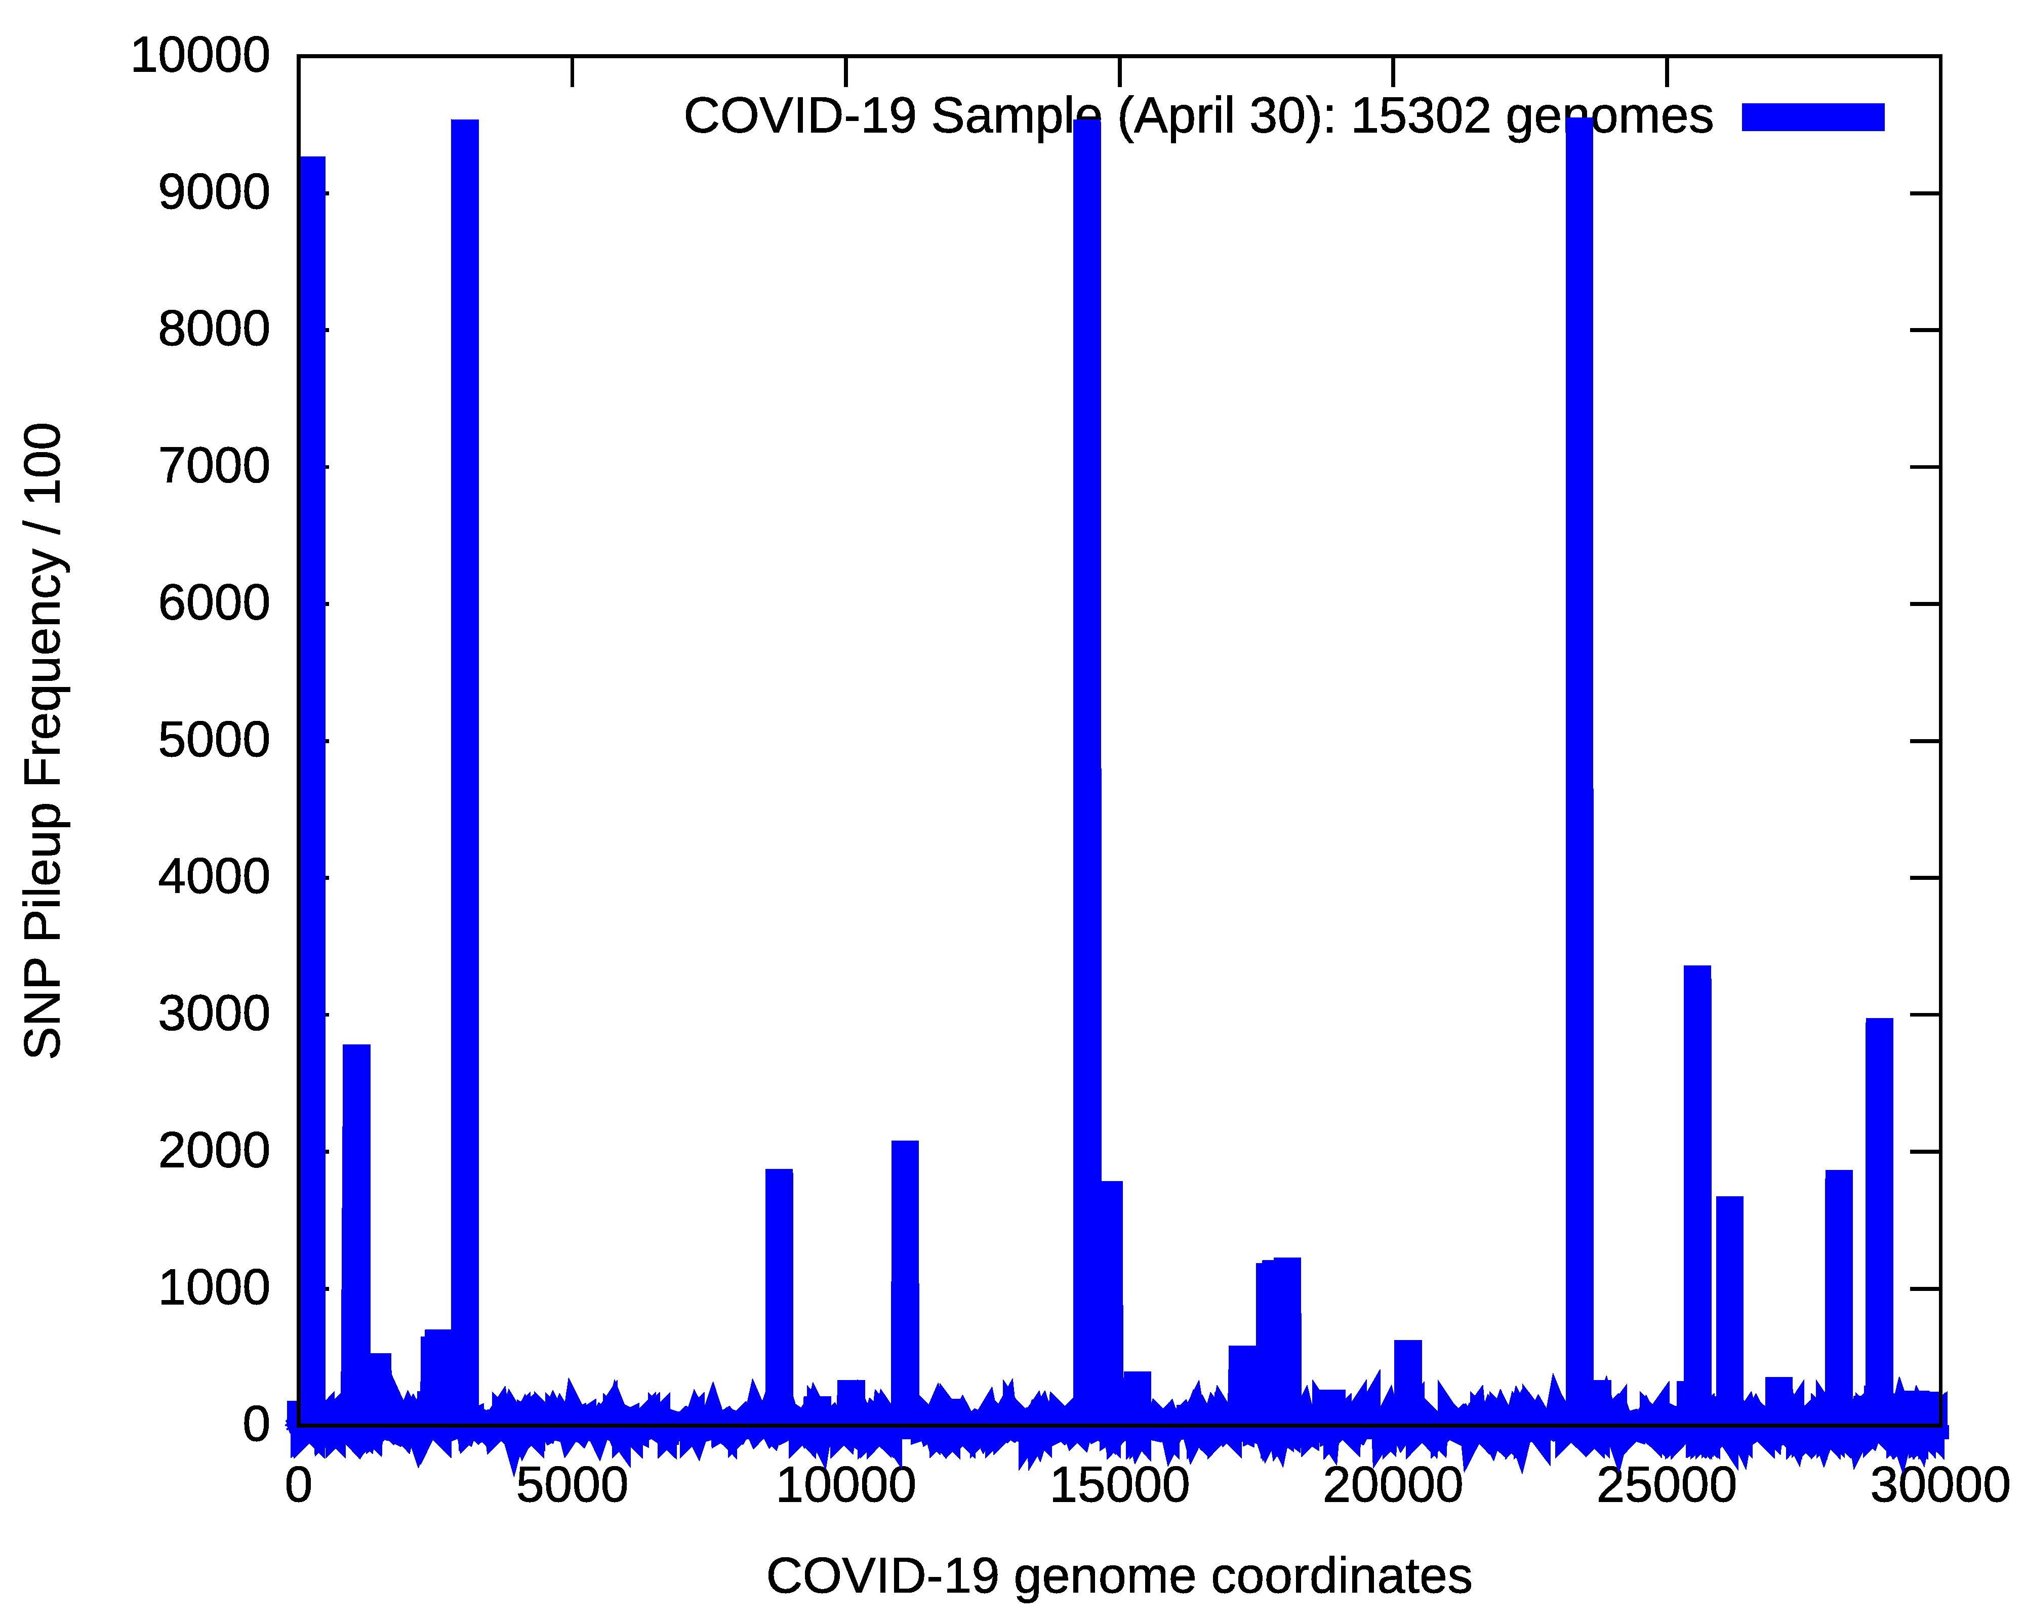
VPF – Variant Pileup Format
1
i
G

Slide 9
1
UK
j
N. Ireland
USA
G

Slide 10
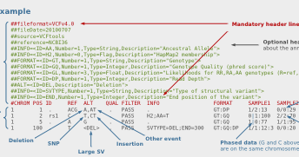

VCF
1
VPF
j
G

Slide 11
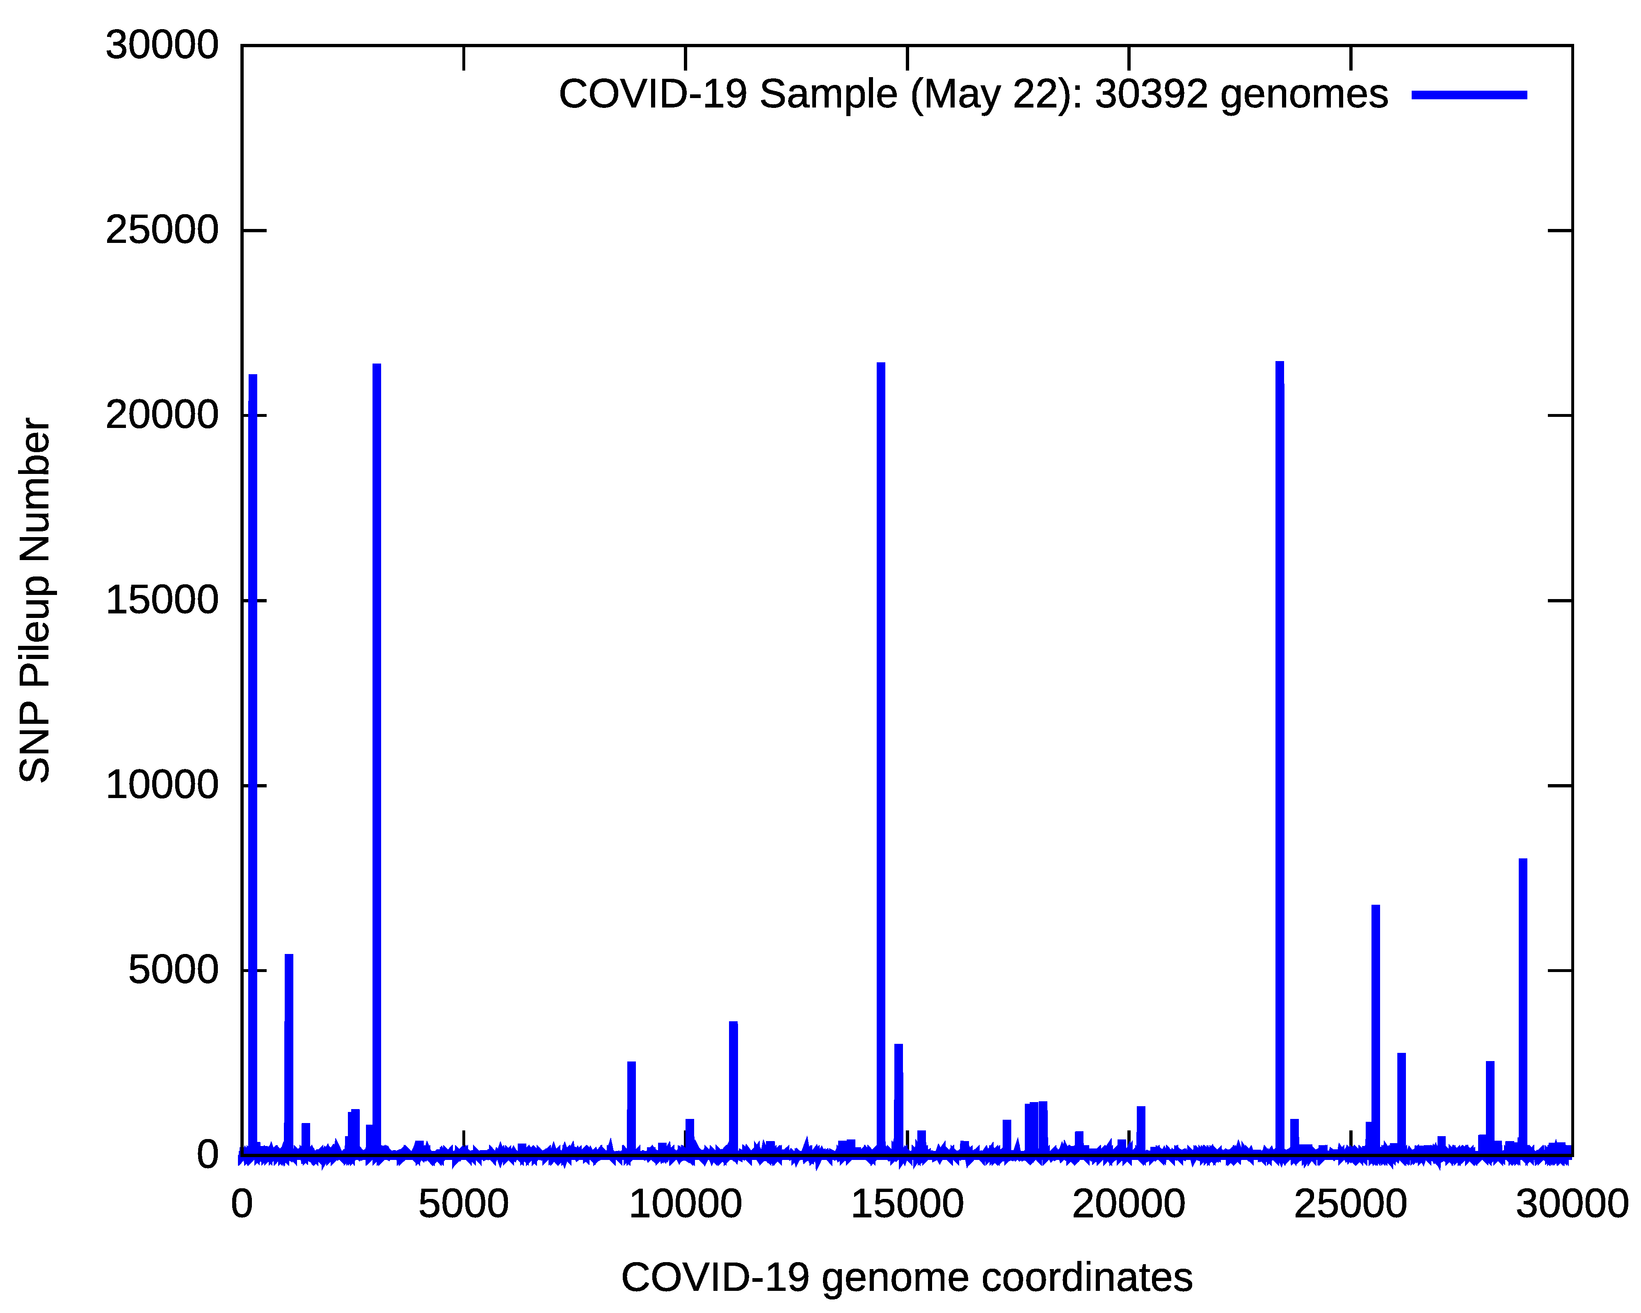
COVID-19 SNP Pileup
C241T
C3037T
C14408T
A23403G

Slide 12
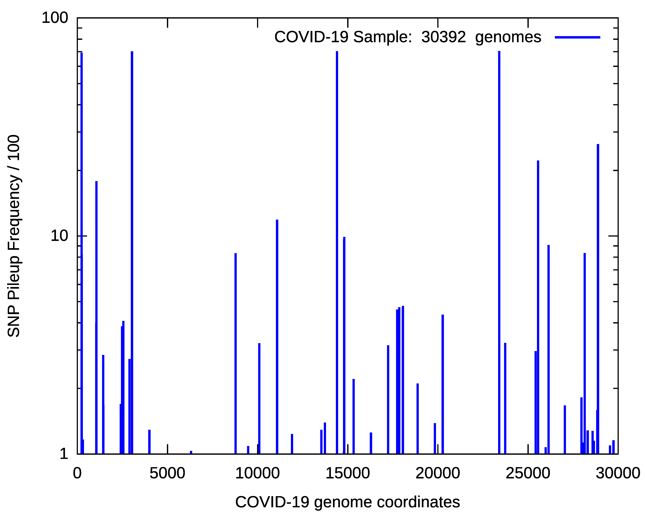
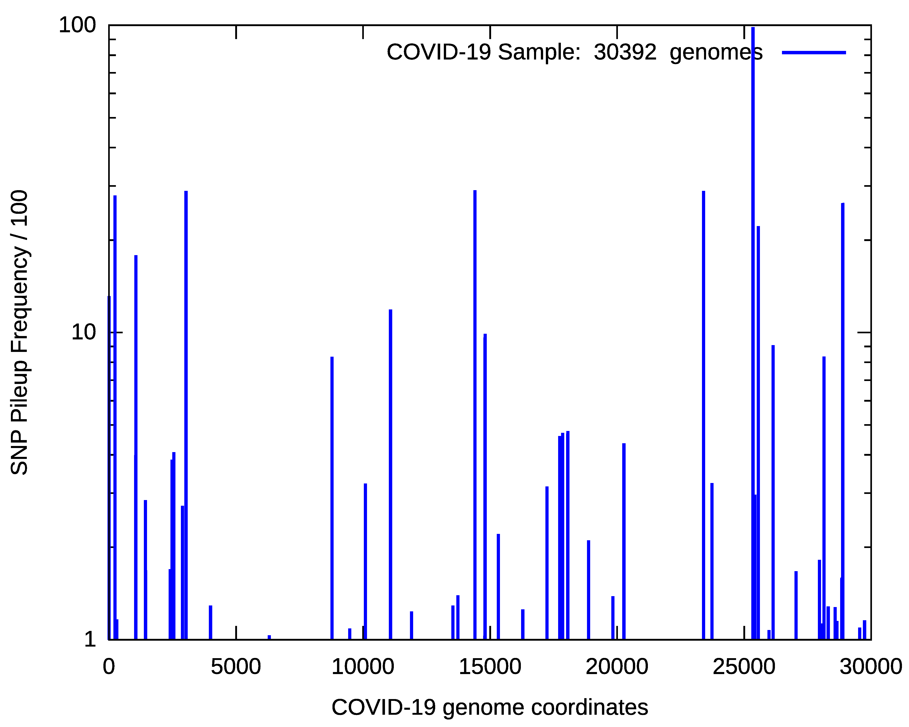
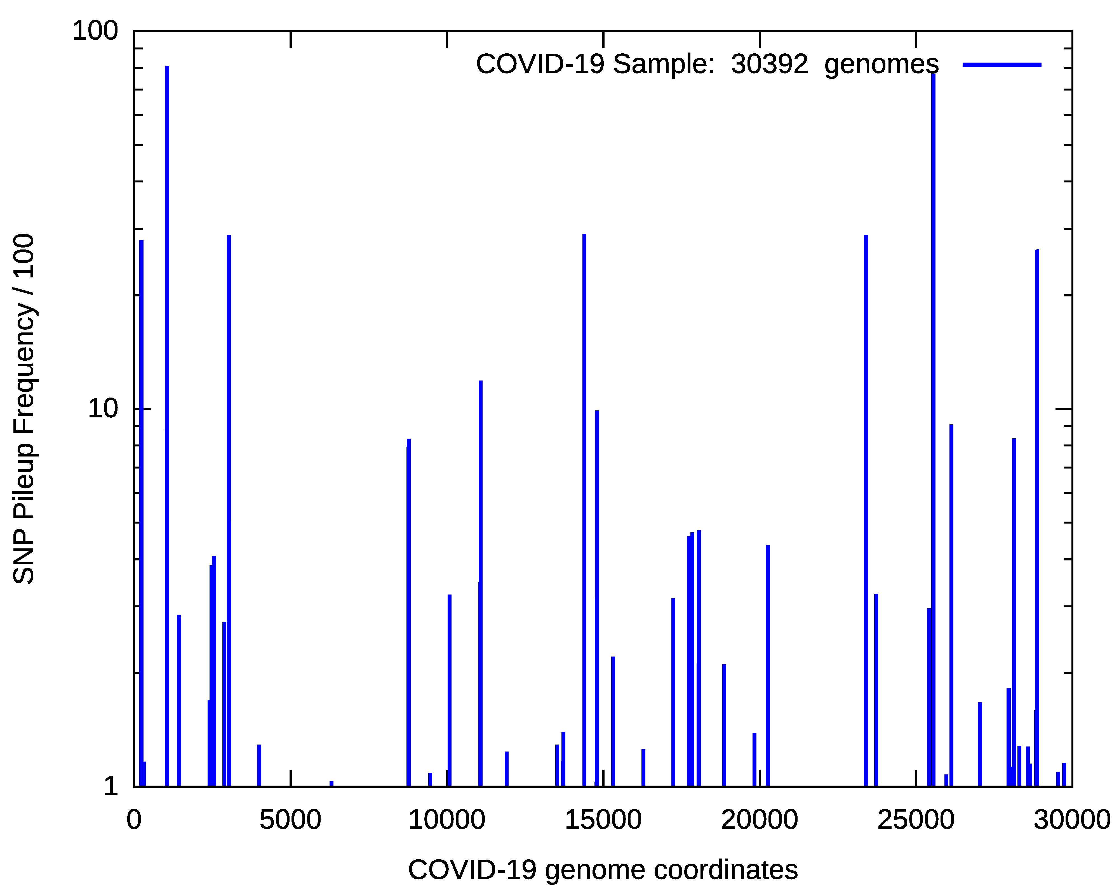
Reference Genome
Genome from England
Genome from Tiger

Slide 13
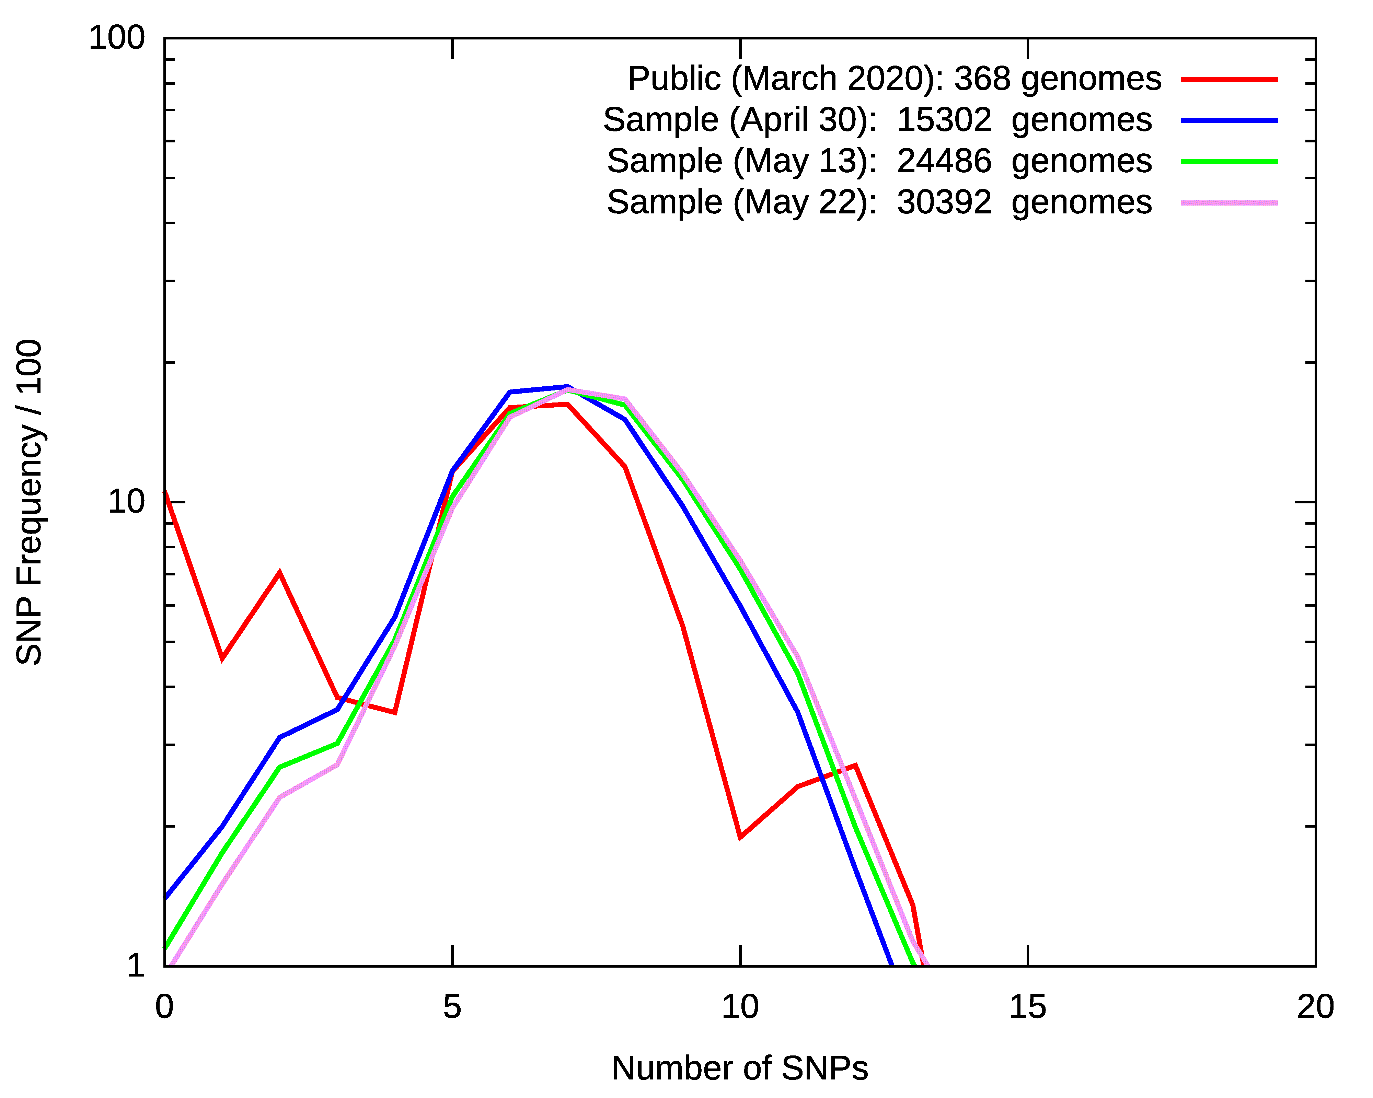
COVID SNP Number/Sample
Species | #Samples | Average_SNPs
Bat | 3 | 2424
Pangolin | 9 | 3466
Dog | 2 | 8
Cat | 1 | 8
Envioroment | 12 | 7
Mink | 13 | 10
Tiger | 1 | 6

Slide 14
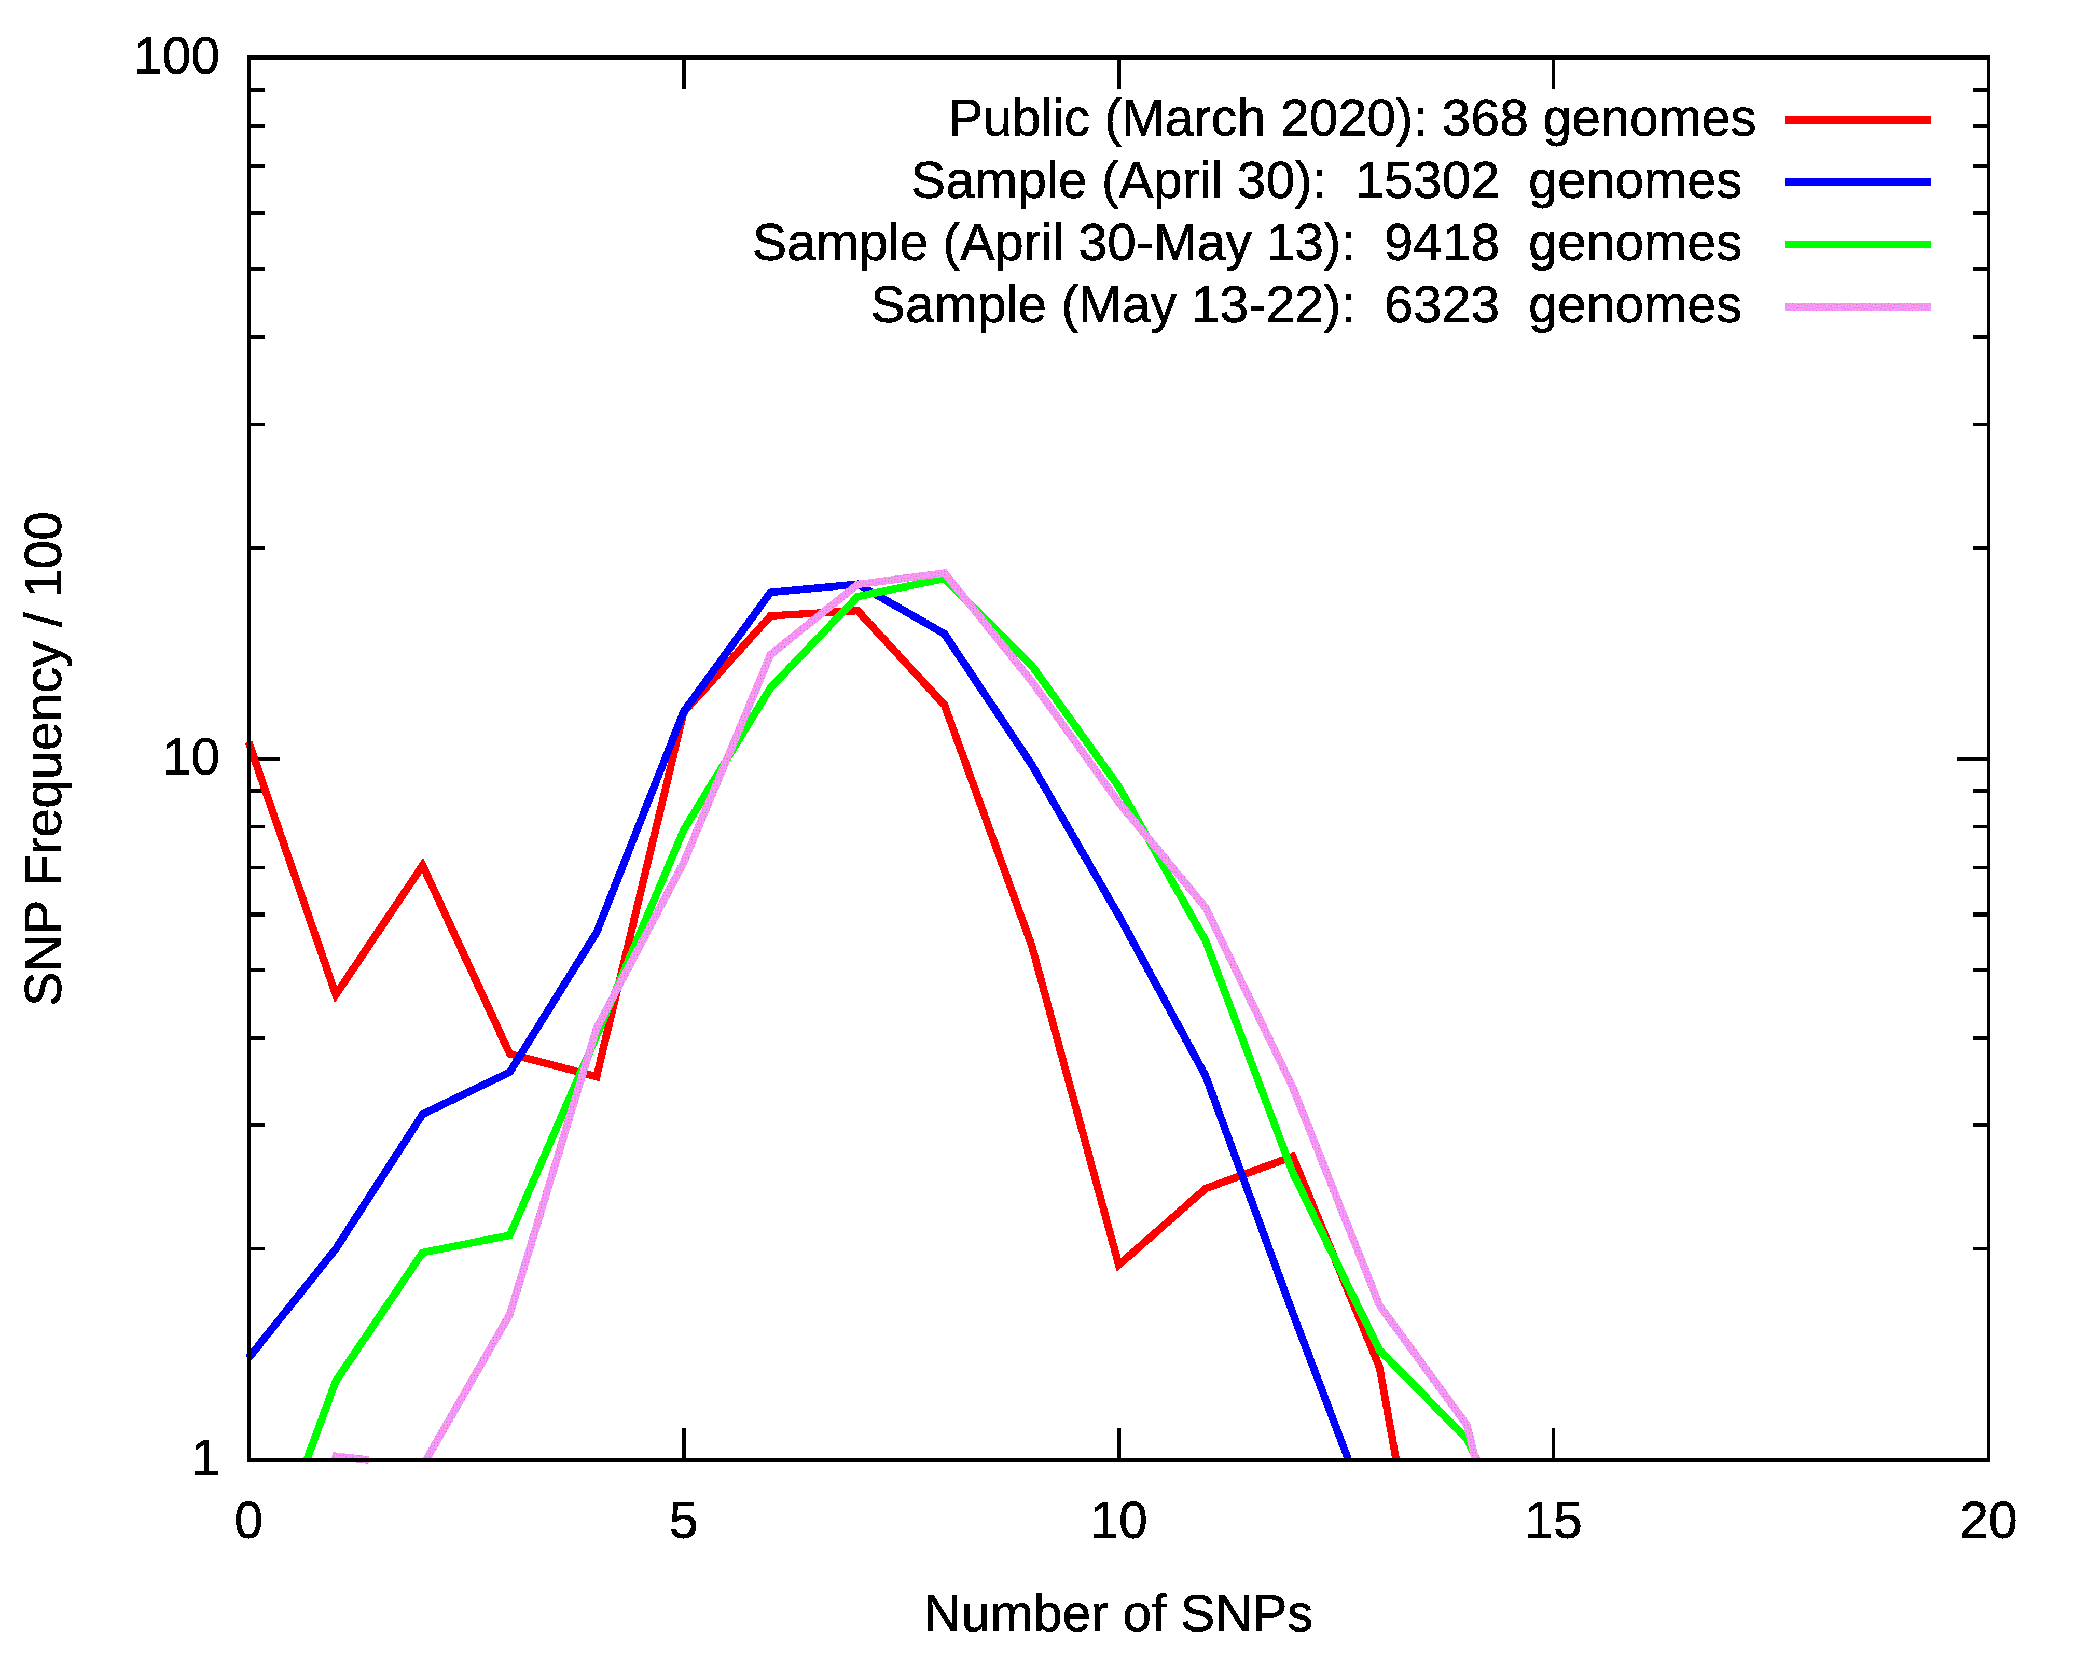
2 SNPs
from March to May

Slide 15
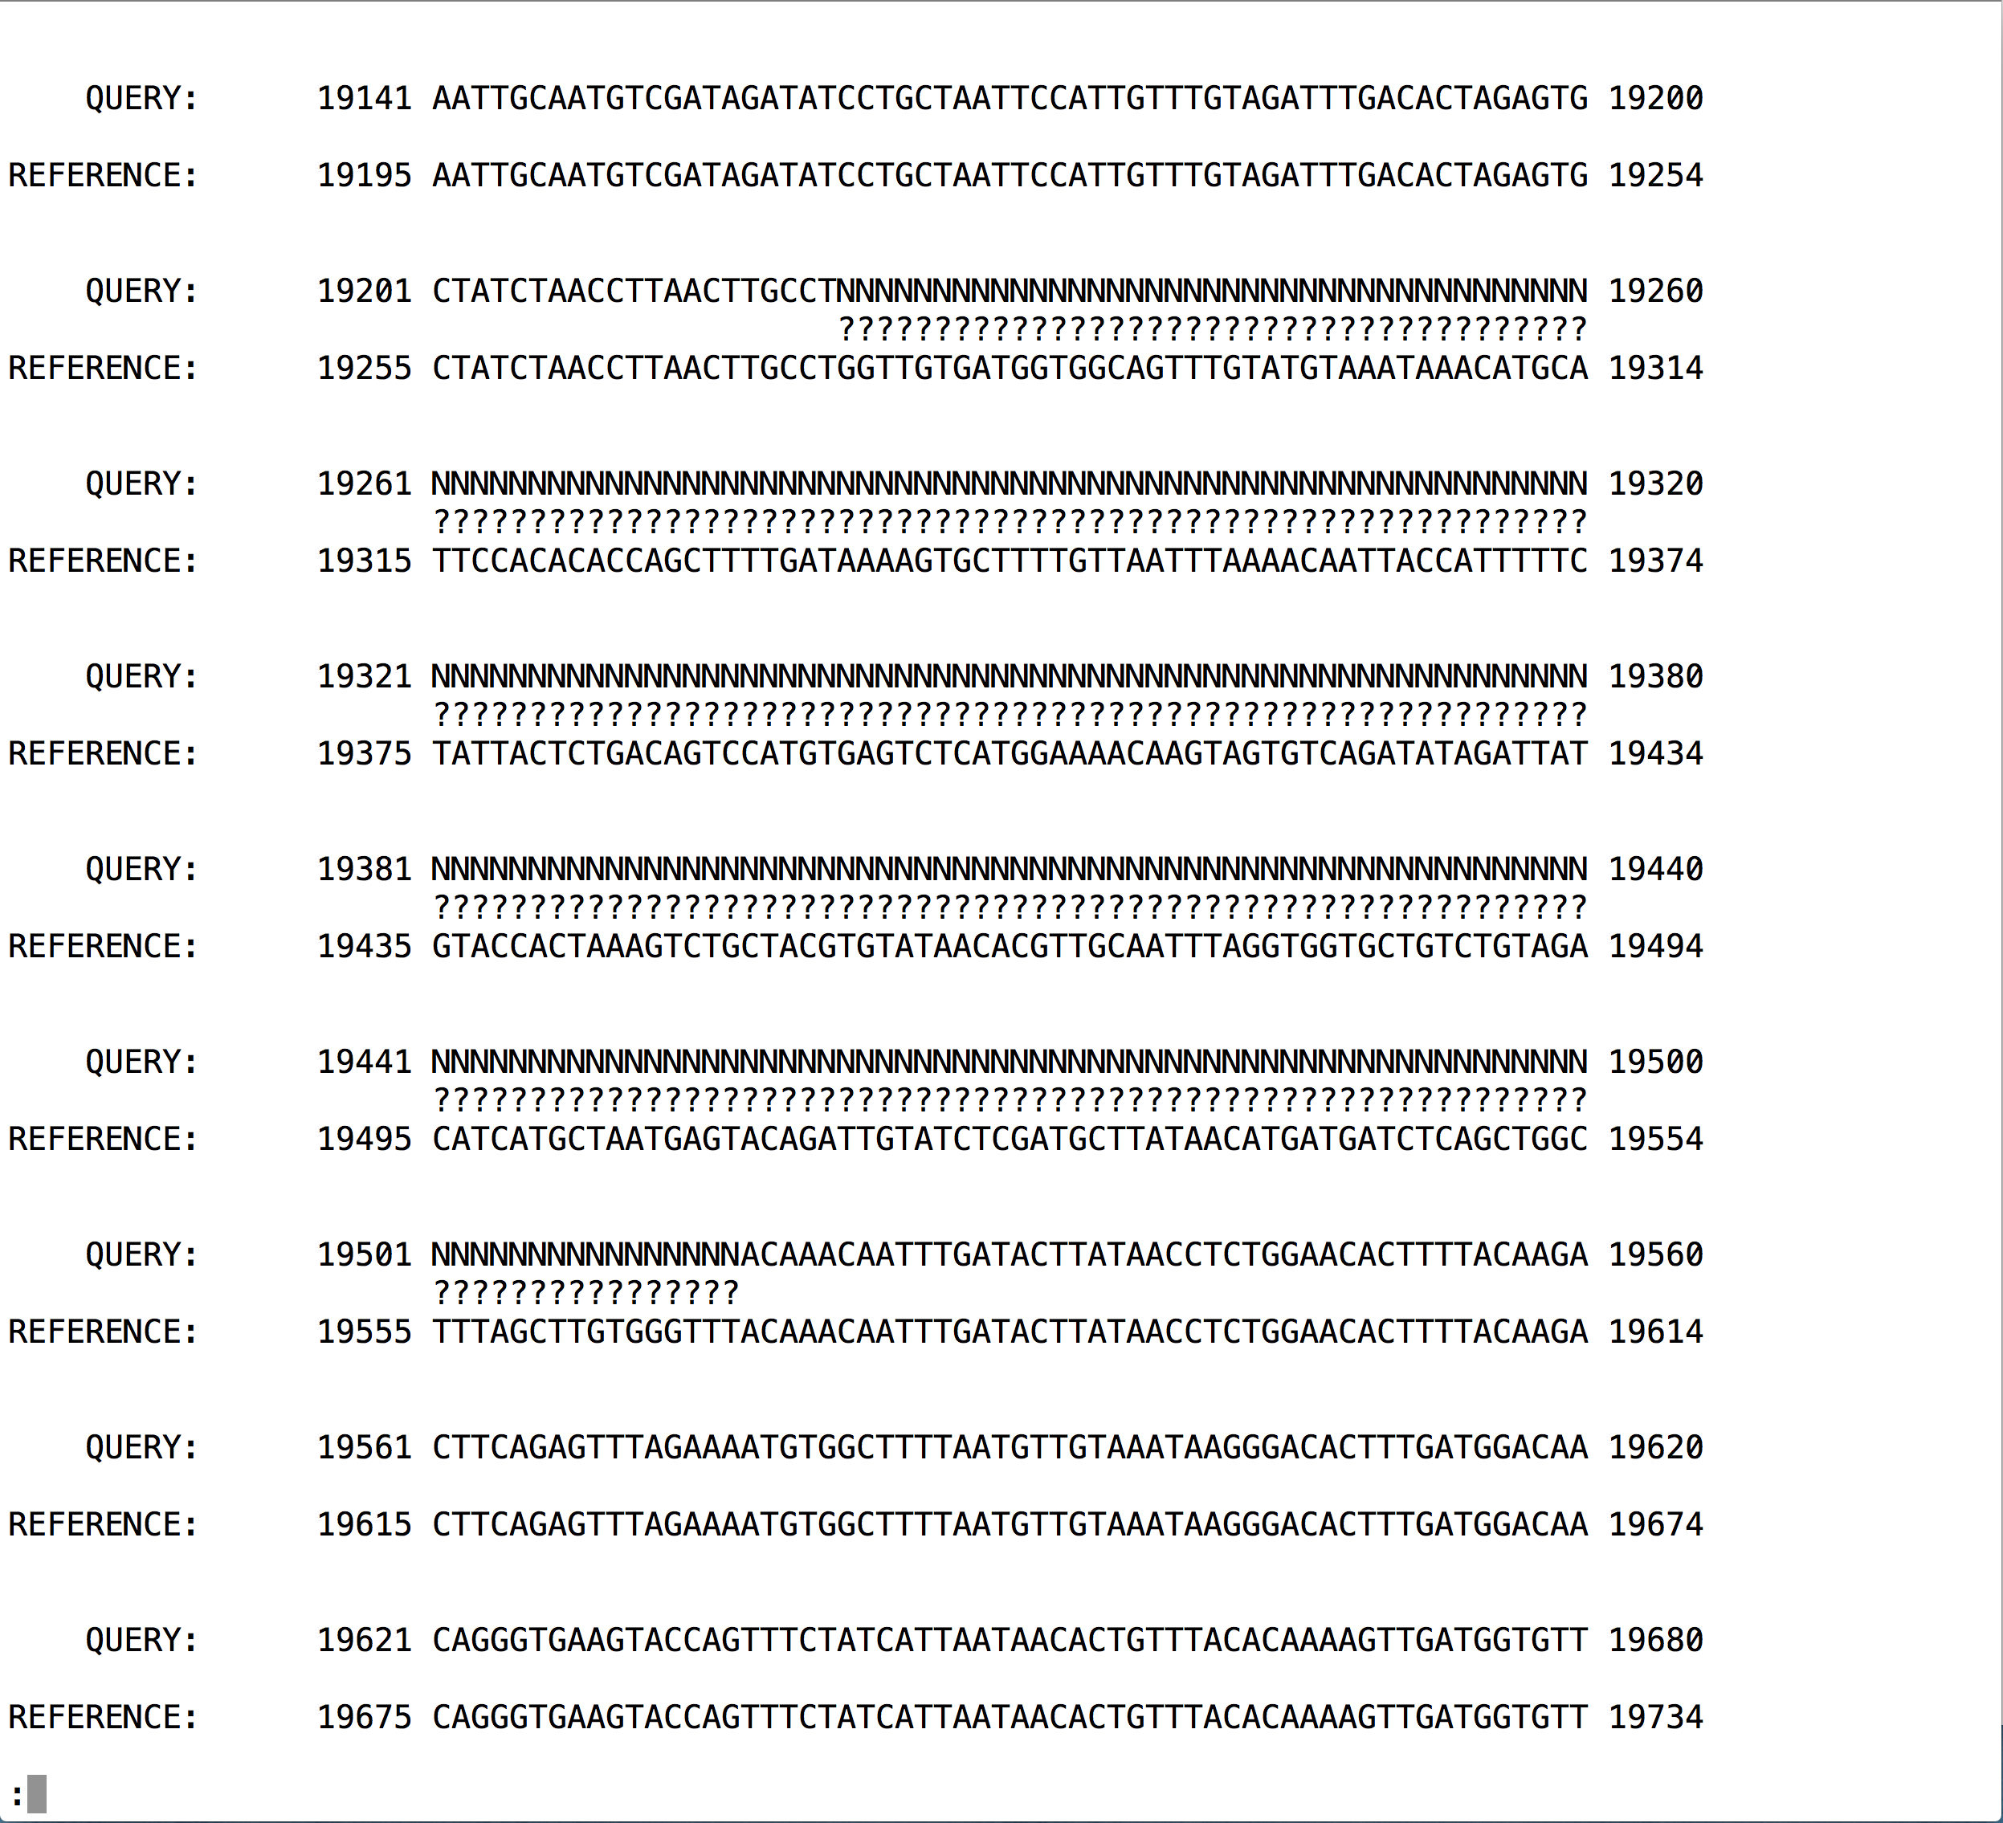

Slide 16
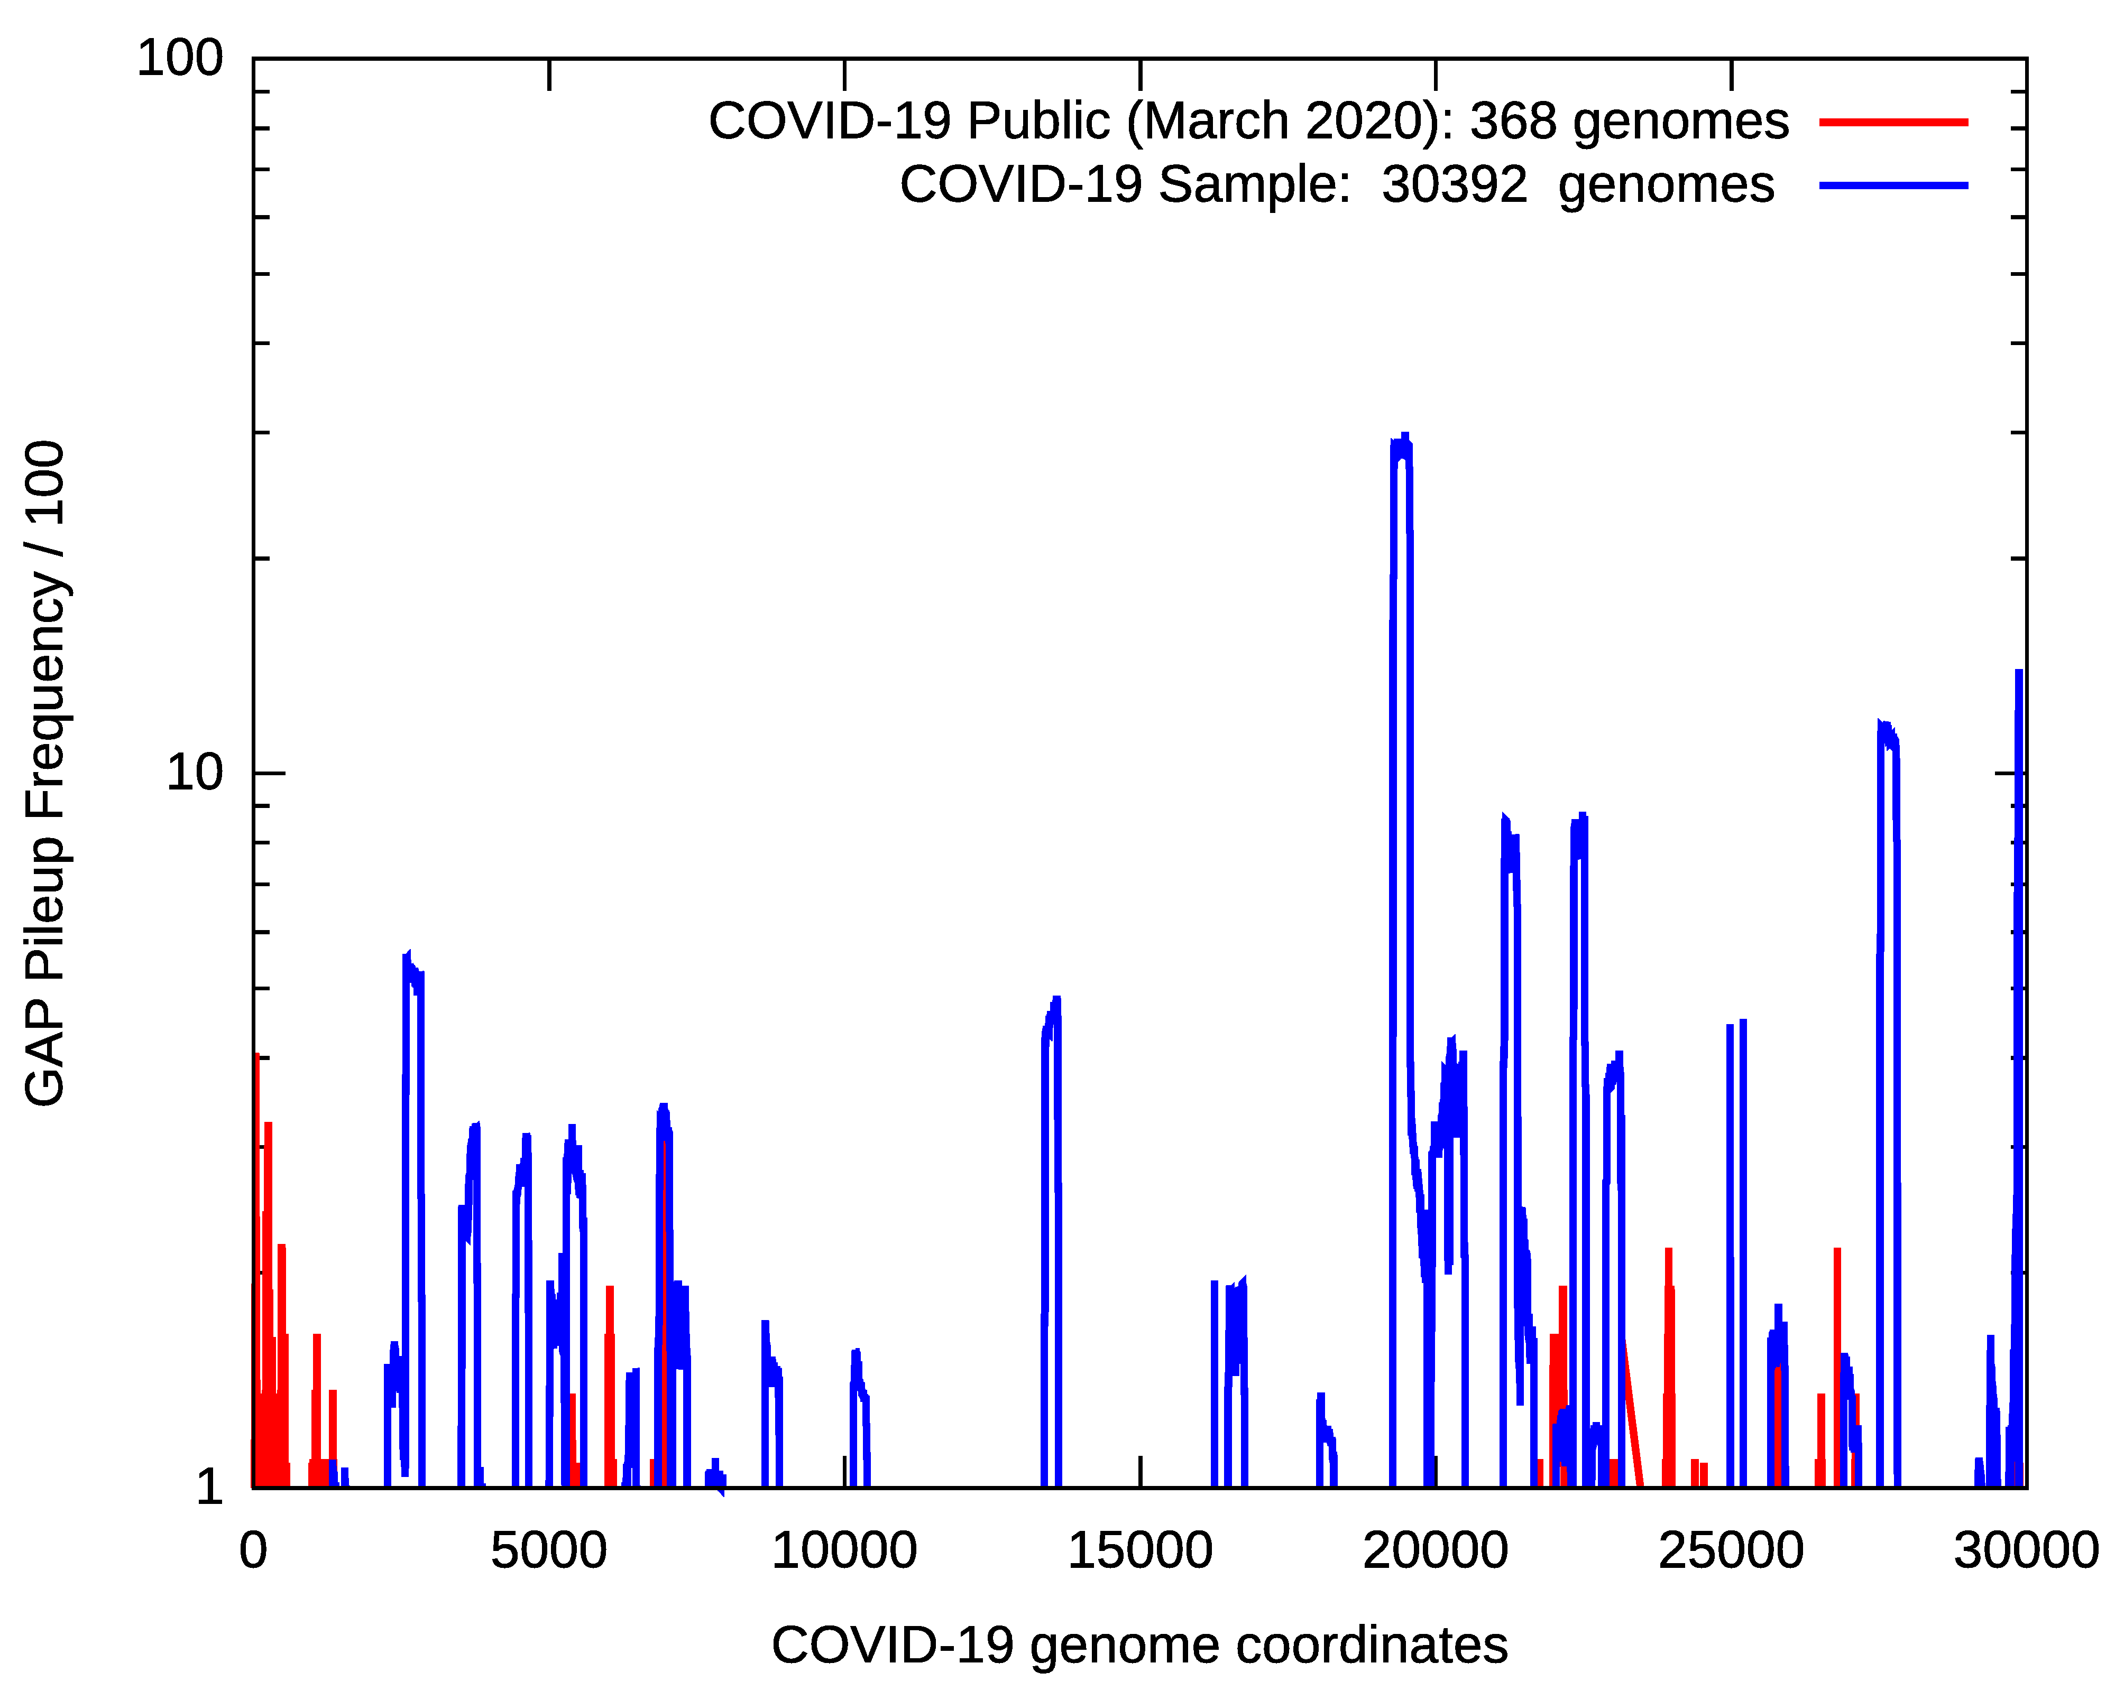
~30% of All Genomes
Have Gaps at 19200-19400

Slide 17
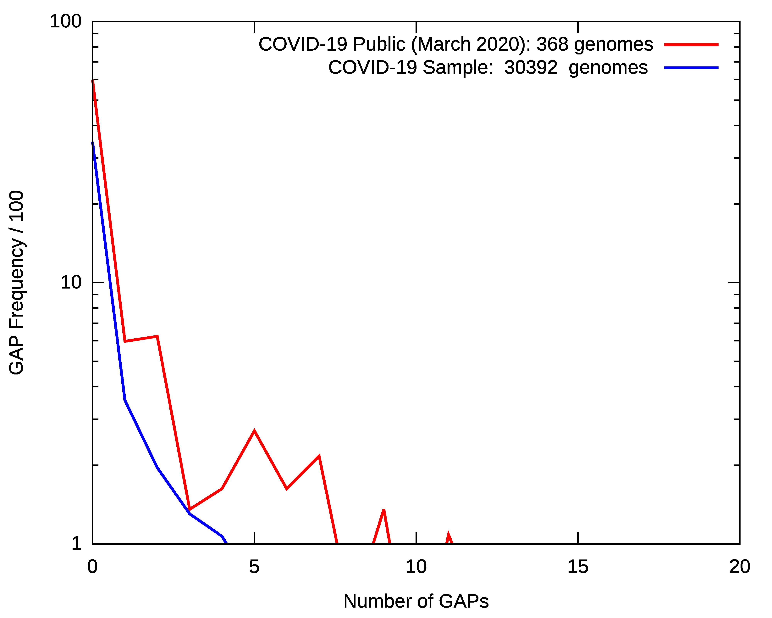
~32% of Sequenced Genomes Have No Gaps

Slide 18
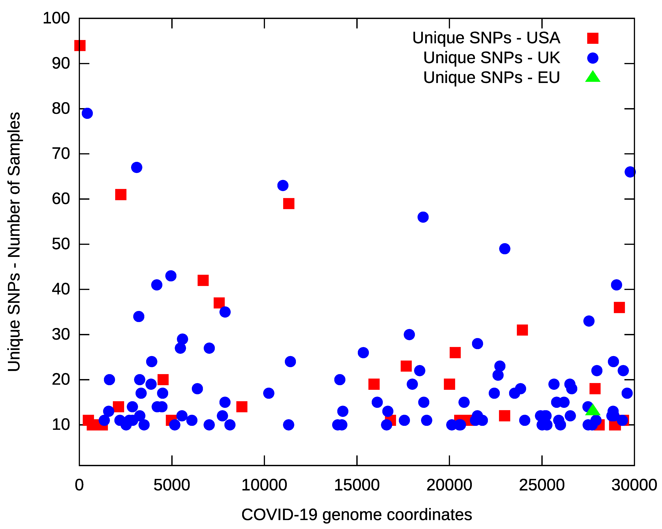
Zero Gaps
60% of Public Genomes
0.5% of Sanger Genomes

Slide 19
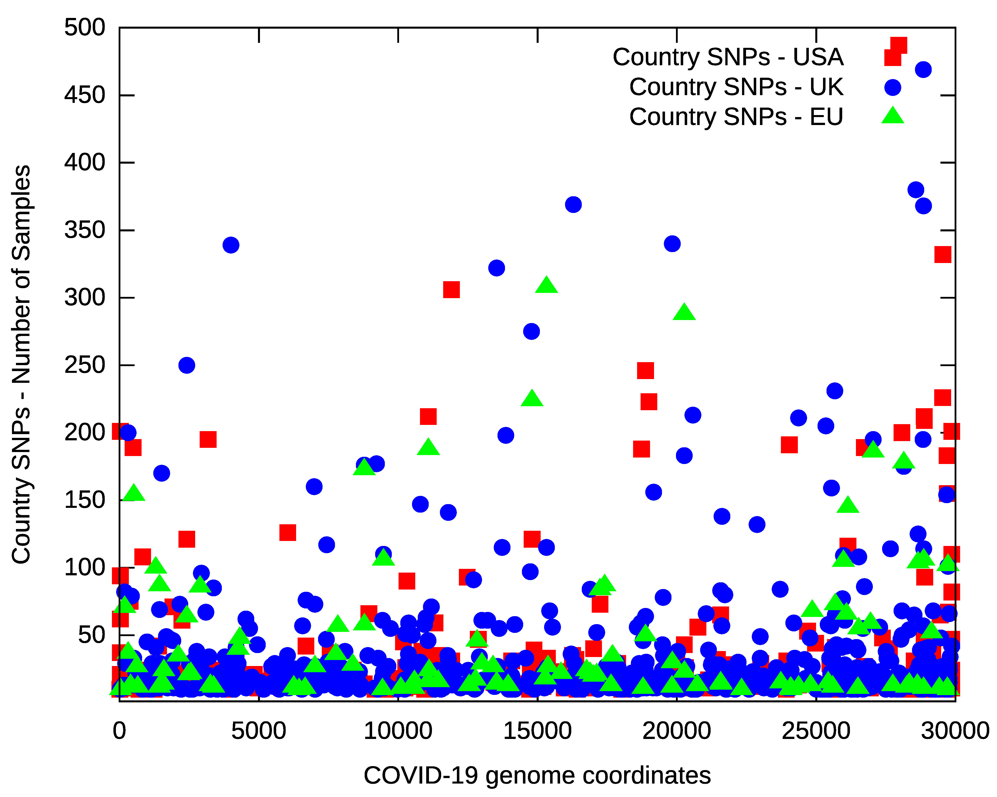

Slide 20
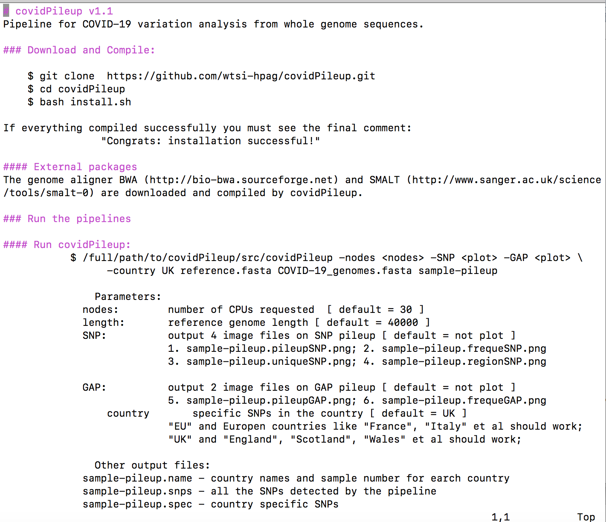

Slide 21

Acknowledgements:
David Jackson
Jonathan Nicholson

